Slide 1

Abroad Squad + Chris
Ciao!
Patrick Zambri, Bradford Harris, Marisa Proscia, Chris Siena, Jacob Levinson

Slide 2
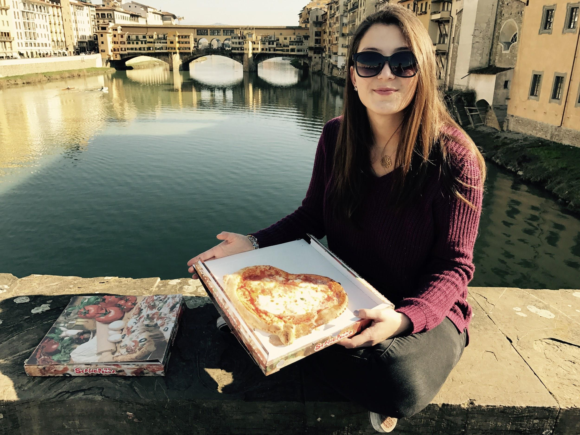
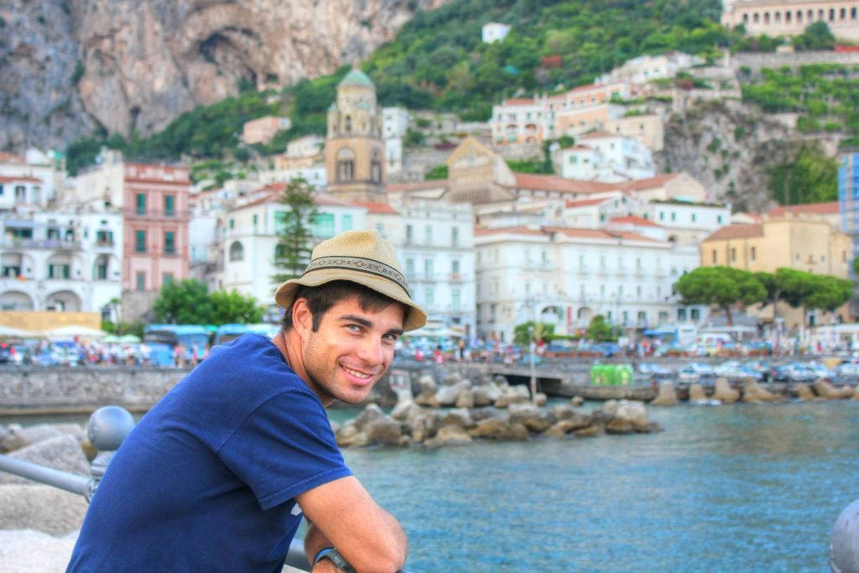
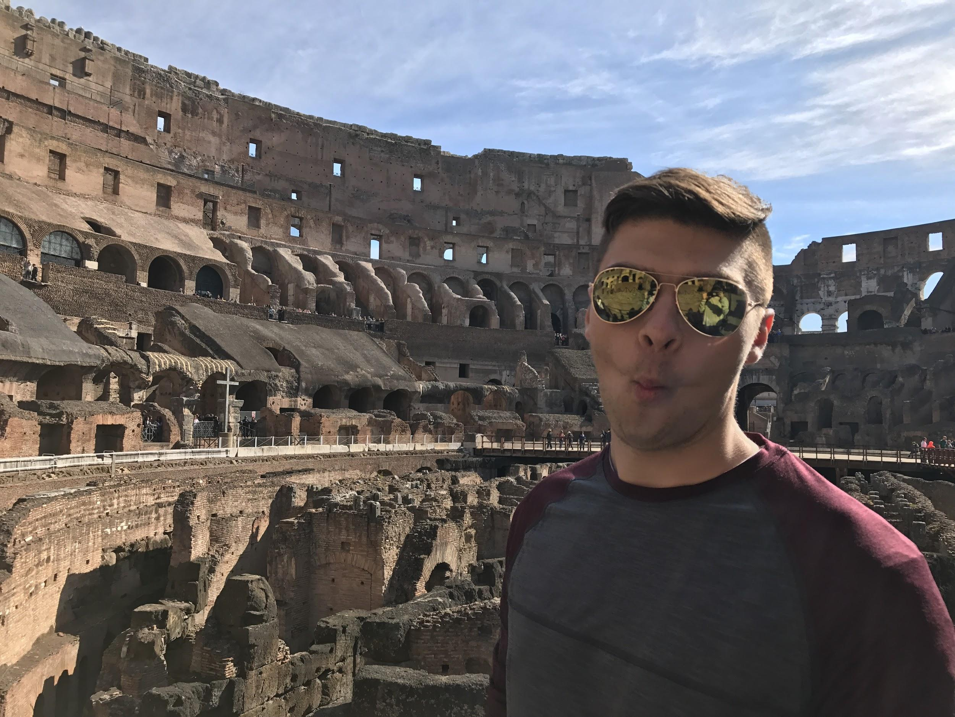
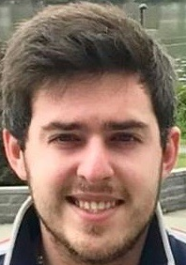
Team Pictures
(Pat)
(Pat)

Slide 3
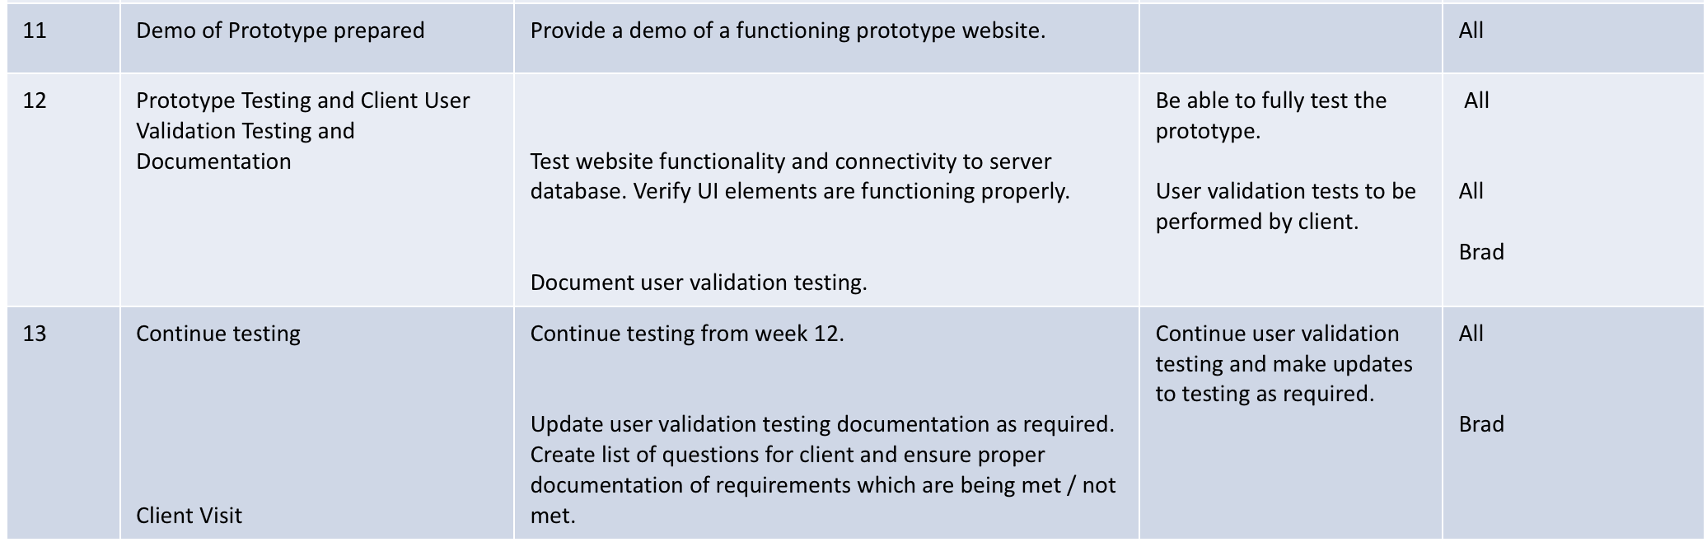
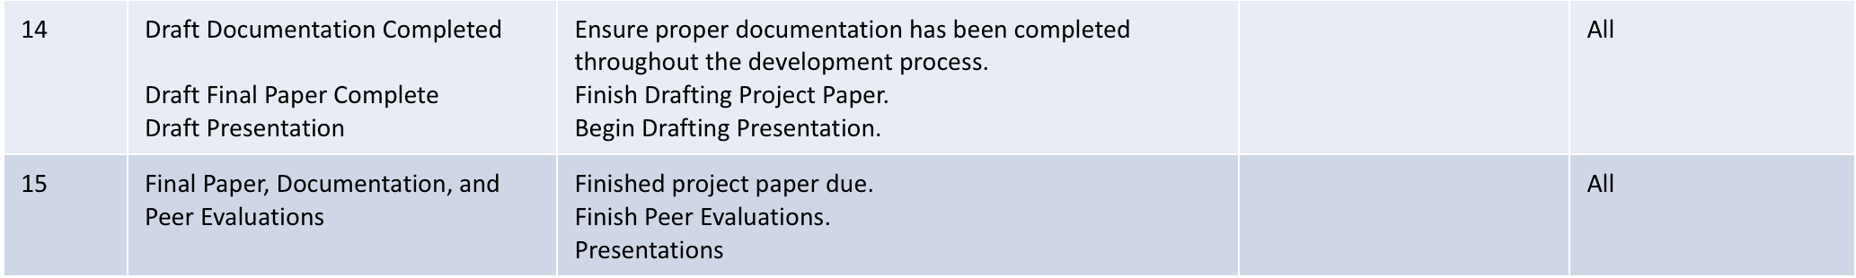
Schedule

Slide 4
Project Status
 | Technical | Family Tree
 | Technical | Website functionality and design
 | Resource | Documentation and resource organization
 | Technical | Set up site on Google server
 | Technical | Trouble with external Postgres connection on Google server

Slide 5
Project Progress
Accomplishments
Family Tree
Set up site on Google server
Activities Being Worked
Overall styling and functionality
Making calendar dynamic with links
Associating calendar with database information
Fixing issue with external Postgres connection to Google server
Roadblocks
n/a

Slide 6
Scope of Project
What it is | What it is not
A website and mobile application | A desktop application

Slide 7
Project Risks
Risk | Score | Mitigation
Time .. Nothing new | High | Keep working.

Slide 8
Project Issues
Issue | Owner | Action Plan | Checkpoint Date
Time | Everyone | Keep developing | 11/1/2017
Postgres Connection | Pat and Chris | Research, then office hours | 11/15/2017

Slide 9
Lessons Learned
Lessons Learned | Corrective Action / Recommendation
Gathering Client Requirements is the most important step in the development process | Ensure all clients needs are going to be satisfied by the system design by asking questions before and during the development process.
Always ask for help | It is great to work out a solution on your own, but in some scenarios it is best to reach out to others for assistance, versus spending too much time on something.
Encryption troubles | Learned how to correctly install and configure MCrypt on ubuntu 14
Mobile First! | We picked Bootstrap as our CSS Framework because of its push for a responsive mobile UI.
Apache is Case-sensitive | We ran into a problem with our files claiming they were not deployed on the server. It turns out some were uppercase and some were lowercase. We figured it out now.

Slide 10
Communication Matrix
Stakeholder Name | Information Required | Timing / Frequency | Delivery Method | Owner
Client (Professor Rivas) | User Requirements | As Needed | Forum Posts, via email | Entire Team
Team Meeting | Team updates, system updates, complete homework | Meet weekly , communicate almost daily | In-Person Meeting, Group Chat | Entire Team

